Slide 1
VR Provider Training:
Trial Work Experience Services
July 2026

Slide 2
Goals for Today
Review the purpose of Trial Work Experience
Discuss Strategies to Build Collaborative Relationships
Review Trial Work Experience Services
  Referral
  Provision of TWE
  Report
Answer Questions

Slide 3
Introduction to Today’s Topic
Trial Work Experience Services -
Purpose of Trial Work Experiences
Provider Guide to Trial Work Experience Services will be available on VR CPS
The Trial Work Experience Referral and Trial Work Experience Report have been updated.
  The report will be available on VR-CPS.

Slide 4
Introduction – Employment First
Employment First Framework
Promotes the belief that all people can work regardless of disability and that pursuing competitive integrated employment (CIE) should be an option for all
Indiana embraces the Employment First Framework
Reason that Trial Work Experience is very rarely used

Slide 5
Eligibility Criteria – Presumed to Be Able to Benefit
It is presumed individuals can benefit from the provision of vocational rehabilitation services in terms of an employment outcome.
Rarely VR might come across an individual for whom we have significant concerns about their ability to successfully work in competitive integrated employment, (CIE), due to the individual’s disability.

Slide 6
TWE Services are used due to significant concerns about ability to benefit.
Prior to VR determining that someone cannot benefit from VR services, VR must conduct an exploration of the capacity to perform work.
There must be clear and convincing evidence that the individual cannot work.
Trial Work Experiences can be used to gather clear and convincing evidence that CIE will not be possible.

Slide 7
VR will use TWE services in the following situations:
TWEs are to be used in 2 situations:
Before Eligibility Determination – Most Preferred Option
  When Intake VRC questions the ability to benefit
Shortly After Eligibility Determination – Less Preferred Option
  Information comes to light during plan development
VR will no longer use TWE after provision of extensive VR services

Slide 8
Required Components of TWEs
Required Components of Trial Work Experience Services:
Be of sufficient variety over a sufficient period of time
Provided in competitive integrated employment setting to the maximum extent possible
VR must provide appropriate supports
  AT devices, personal assistance services, job coaching, etc.

Slide 9
How to Discuss TWE services with Participants and Families (1):
TWE services are provided due to significant concerns about the participant's ability to achieve CIE.
However, it is important to take care to discuss TWE services in a sensitive manner.
As with any other service that VR provides, we want participants to feel supported and know we are hoping for success.

Slide 10
How to Discuss TWE services with Participants and Families (2):
Explain the TWE process carefully, providing reassurance and necessary supports
Use info in the referral and find out about the individual’s likes and dislikes to develop a TWE site that is suitable.
Be positive in your interactions to promote a collaborative relationship.

Slide 11
How to Discuss TWE Services with Participants & Families (3)
Good Example - Positive conversation to promote collaboration:
Meet in person, “VR has referred you for TWE services because they have some concerns about your ability to work. We want to help you to further explore your abilities and capabilities. We are going to arrange opportunities to try out work by setting up work experiences where you will go to a worksite and try out some real work. We will work with VR and provide you with the supports that you need on the worksite, and you will be able to see what it is like to work in that type of job. After the first TWE, we will meet and discuss what we learned, and determine if we should arrange for a second TWE.”

Slide 12
How to Discuss TWE Services with Participants & Families (4)
Poor Example - More likely to result in contentious relationship: While meeting with the Participant you say “VR doesn’t think that you can work, so we are doing this trial work experience. We are going to arrange for you to go to a job site and prove that you can do all the work that we set up for you. You need to able to demonstrate that you can meet all the employer’s expectations or VR will be closing your case.”

Slide 13
Important to include individual in developing the TWE
If the participant has been involved, supported and feels like they had a fair opportunity, they are more likely to accept any difficult news from the VRC. They may even come to the same conclusion.
In some cases, no matter how much support was given and care was taken in providing the TWE and delivering the difficult news, the participant or family may disagree or be unhappy.

Slide 14
VR Predicament
The VRC
Has significant concerns about the individual’s ability to successfully work (otherwise would not be providing TWE services).
VR must gather clear and convincing evidence to determine they do not appear to be able to benefit from services.
The Participant
TWE services are an opportunity to explore their abilities & capabilities for employment.
Is included in developing Work Site.
Must receive a fair TWE with all the supports they need.
Hope that the participant can come to the same conclusion that we do.

Slide 15
Segue
Now, we are going to talk about the TWE Service process. But before we continue are there any questions about what we have discussed so far?

Slide 16
Before VR Referral for TWE Services
The VRC will
Carefully explain the purpose of the TWE and explain what to expect.
Consider likes and dislikes, skills and abilities.
Develop the TWE plan

Slide 17
Before VR Referral for TWE services - Assistive Tech
The VRC will
Complete any necessary AT evaluations
Obtain any Assistive Tech (AT) before referring to TWE
  Borrow from Easterseals Crossroads AT lending library
  Use low tech options

Slide 18
TWE Referral
VRC will send TWE Referral & Trial Work Plan
Description of impediments, challenges, and barriers to CIE:
    Provide critical details the ES needs to be aware of, such as safety concerns, likes and dislikes, abilities and capabilities
    The objective is to provide appropriate information but to allow for an objective evaluation.
Description of TWE expectations including duration, activities and examples of work settings.
    Provide specific expectations, ideas, and if appropriate openness to a discussion of other ideas.
    Indicate expectations for a kickoff meeting, meetings after first TWE.

Slide 19
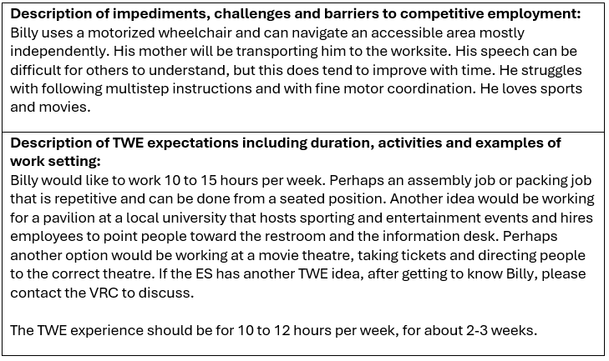
TWE Referral - example

Slide 20
TWE Plan - slide 1
Helpful to note:
Purpose and Rationale
Purpose – to determine if participant can work in CIE
Rationale - Provides a brief history describing reason for the TWEs, providing enough information that will allow for an objective evaluation.
Example:
The purpose of the TWEs is to determine if Sally can successfully work in competitive integrated employment with supported employment.
Sally has a long and recent history of requiring constant supervision in almost all environments. She cannot focus on or engage in tasks for more than 5 minutes at a time. She does not follow instructions, which causes her to put herself and others in danger. For example she has a tendency to run out into the road or parking lot without looking for traffic. She has applied for VR services because her team thinks that employment will relieve her boredom and help improve her behaviors. They are hopeful that she can work if she finds the right job.

Slide 21
TWE Plan - slide 2
Take note of:
Description of TWE –
Described some work settings that would be a good fit, in line with the likes and dislikes.
How many days per week, hours per day.
Example
Sally does like to be around people. She is not bothered by noisy environments. These are the ideas for worksites:
Restaurant - rolling silverware, clearing tables.
Gym, Hotel or Beauty Salon- Folding Towels, washcloths and putting them where they go.
She would like to work about 10 hours per week:
3 days a week for 2-3 hours a day for 3 weeks - to give her a full opportunity to adjust and learn the job.
Provide one of the above TWEs, and then the team will meet to determine if second one would be appropriate.
Employment Specialist: if after you get to know Sally, you think of another work site or possible job, please call VRC to discuss.

Slide 22
TWE Plan – Slide 3
Note:
Participant Responsibilities
Responsibilities should refer to things that participant must do for their VR case, outside of what will be happening on the job site.
  I will be clean, dressed and ready to leave for the job site when the job coach arrives to pick me up.
  I will call and report any concerns to my VR Counselor.
  I will bring my assistive technology to the job site.
  I will keep my appointments or call to reschedule.
  I will give my work schedule to residential staff.

Slide 23
TWE Plan – Slide 4
Note the Criteria to Evaluate Progress/Outcome.
VR will add specifics:
Attendance/punctuality
Behaviors
Completing job tasks
Accepting redirection
Following safety guidelines
The following will help VR understand my potential for working in a competitive integrated employment setting:
I will arrive on time at my job site.
I will cooperate with my job coach
I will accept redirection when it is given to me.
I will follow basic rules for my safety, meaning I will not run away, hide from the job coach, run into a parking lot or road.
I will learn to do the job tasks given to me and then I will stay on task for 20 minutes, with minimal redirection.
I will work at a pace acceptable to the employer.
I will work well with my coworkers and supervisors.
I will keep my conversation related to my job when I am supposed to be working.
We will meet to review the outcome of each trial work experience after I have completed it.

Slide 24
TWE – Authorization
Authorize for TWE and any other services
  Procedure Code – 53-03 @ $50.00/hour.
  VRC determines the number of hours necessary, but the guidelines are:
    6-8 hours for introductions, site development and documentation
    10 to 20 hours per week for 1 – 3 weeks, for the actual TWE.
    Facility transportation as required.
    If a subsequent TWE is required, an additional 2 hours may be authorized for site development and documentation
Notes:
Review the slide

Slide 25
TWE – Getting Started
After receiving a referral for a TWE
Schedule a meeting with the VRC and participant to discuss the TWE services
Discuss any challenges with individual, or worksite set up
Inform VRC of scheduled TWE

Slide 26
During the TWE
The Employment Specialist must be present for the entire TWE
  Providing Job Coaching & Encouragement
  Observing
Ensure the individual uses any AT that has been obtained, note any accommodations that are provided
Take good notes regarding performance, following instructions, communication, likes and dislikes.
Be patient and positive

Slide 27
TWE Report
Trial Work Experience Report – completed at conclusion of TWE.
Available on VR-CPS (in Word or PDF).
Keep notes about TWE, and then at the end complete the Trial Work Experience Report.
  Send copy to VRC
  Schedule meeting to discuss the first TWE with VR and Participant.
  The participant & family will likely see the report

Slide 28
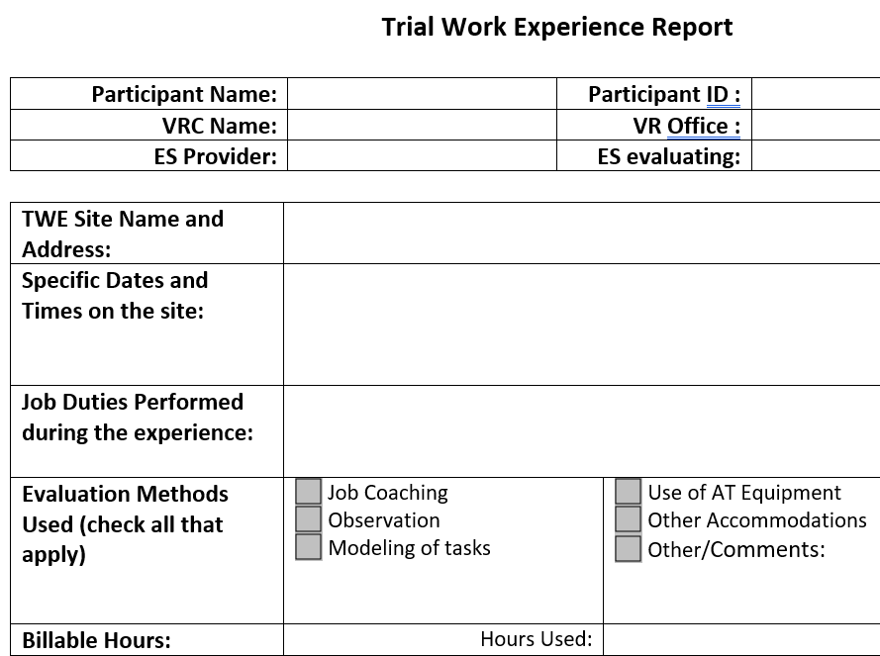
TWE Report – slide 1

Slide 29
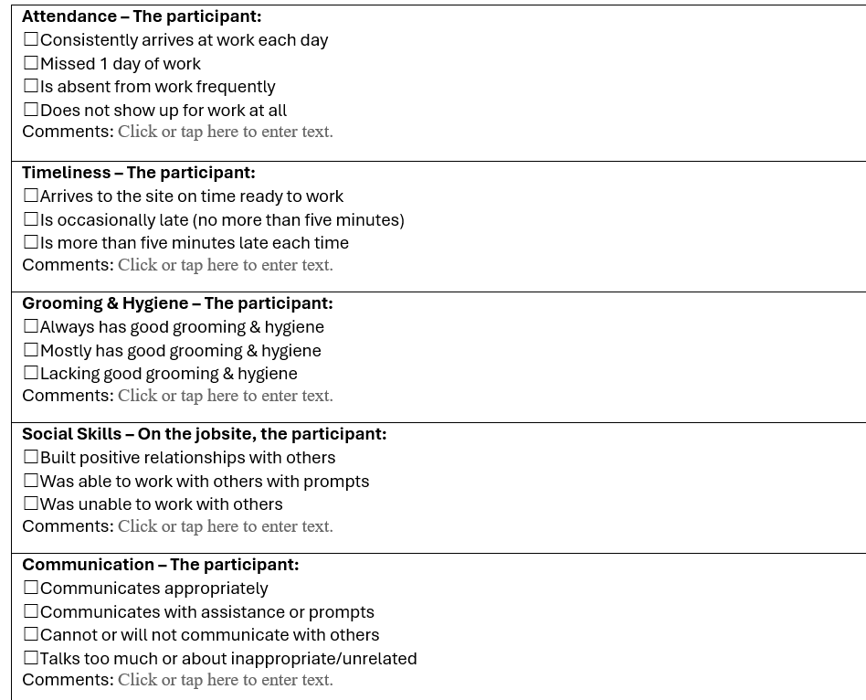
TWE Report – slide 2

Slide 30
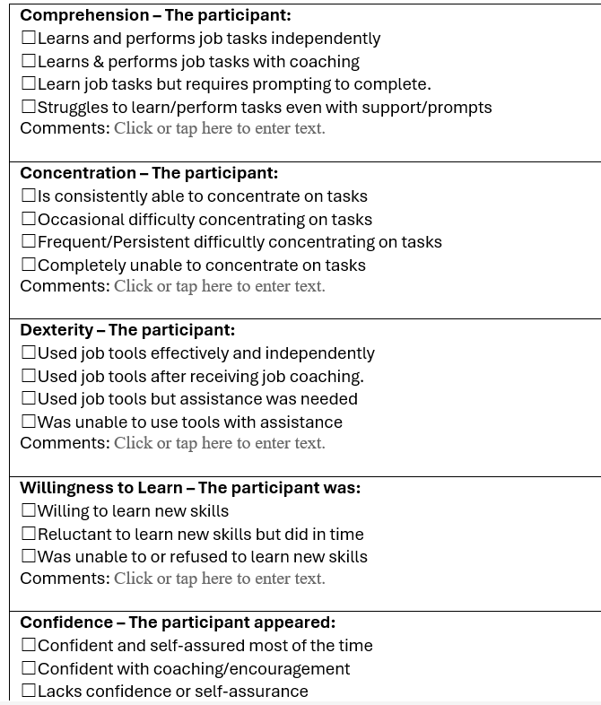
TWE Report – slide 3

Slide 31
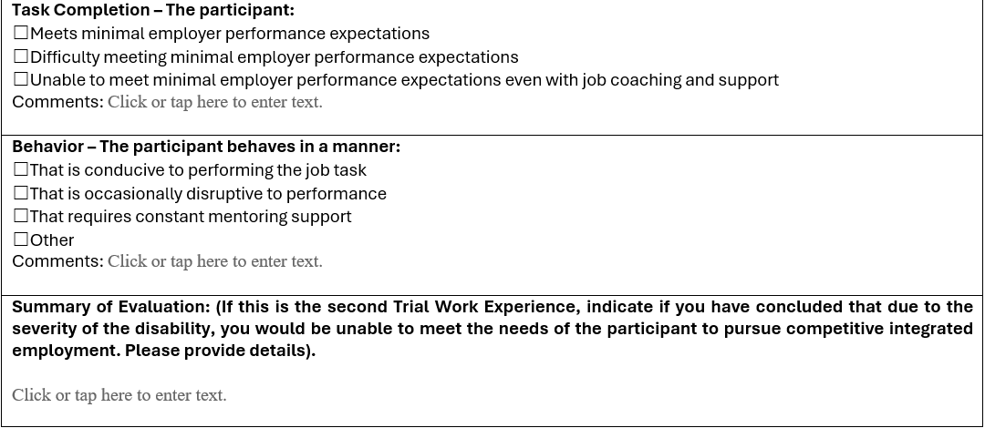
TWE Report – slide 4

Slide 32
Meetings after TWE
The VRC, Provider, Participant & Family will meet after each Trial Work Experience.
The VRC will determine the next steps after reviewing the Report and listening in the meeting.

Slide 33
After the First TWE
It is the role of the VRC to review the report, listen during the follow up meeting, and determine whether the participant can benefit from VR services.
  Meet in person whenever possible, especially to discuss results of TWE.
If, after the first TWE, participant has demonstrated capability to benefit from VR services, VR will determine them eligible or proceed with IPE development.
Notes:
Review the slide.

Slide 34
After the First TWE (cont’d)
If after the first TWE, participant has not demonstrated capability of CIE, VR will discuss options with participant and family.
  If the participant would like another opportunity, the VRC will likely offer a second opportunity.
  If the participant agrees that they don’t think that they can work, it is not necessary to do a second TWE.

Slide 35
After the Second TWE
Completing TWE Report after a second TWE –
In the summary section the ES is asked to indicate if you have concluded that due to the severity of the disability you would be unable to meet the needs of the individual.
Meet to discuss the outcome of the second TWE.
The VRC will make a determination about next steps

Slide 36
Questions?
Now we are going to address some questions
you may have.

Slide 37
Question - Can TWEs be used after extensive employment services or other services have been provided?
Answer: No. Generally speaking, VR will not be providing Trial Work Experience services to individuals that have received other extensive services from VR.

Slide 38
What if we are having difficulty finding an employer willing to host a trial work experience?
Answer – Trial Work Experiences should be conducted in the most realistic setting possible. If you are unable to find an employer willing to host a TWE, they can be conducted in a setting where unpaid work is being conducted, such as a food pantry, church or school. You may need to work with the VRC to find creative solutions.

Slide 39
Question: Are we getting this training because VR anticipates an increase in referrals for Trial Work Experiences?
Answer – No. We are doing this training to ensure that we are using Trial Work Experience Services correctly and consistently. We have recently provided some training to VR staff, and we have updated the forms used for the services.

Slide 40
Question: What does clear and convincing evidence mean?
Answer: Clear and convincing evidence means that VR has a high degree of certainty to conclude that an individual is incapable of benefiting from services in terms of an employment outcome. The clear and convincing standard constitutes the highest standard used in our civil system of law and is to be individually applied on a case-by-case basis. The term clear means unequivocal. For example, the use of an intelligence test result alone would not constitute clear and convincing evidence.

Slide 41
Question: How long or how many hours does a Trial Work Experience need to be?
Answer: The VRC should indicate how many hours and how long the TWE should run. It will depend on the number of hours the individual is hoping to work. We also want to provide the individual enough time to adjust and learn the job. Remember, we are evaluating if the participant has potential to work in CIE, with supports.

Slide 42
Questions?

